Slide 1


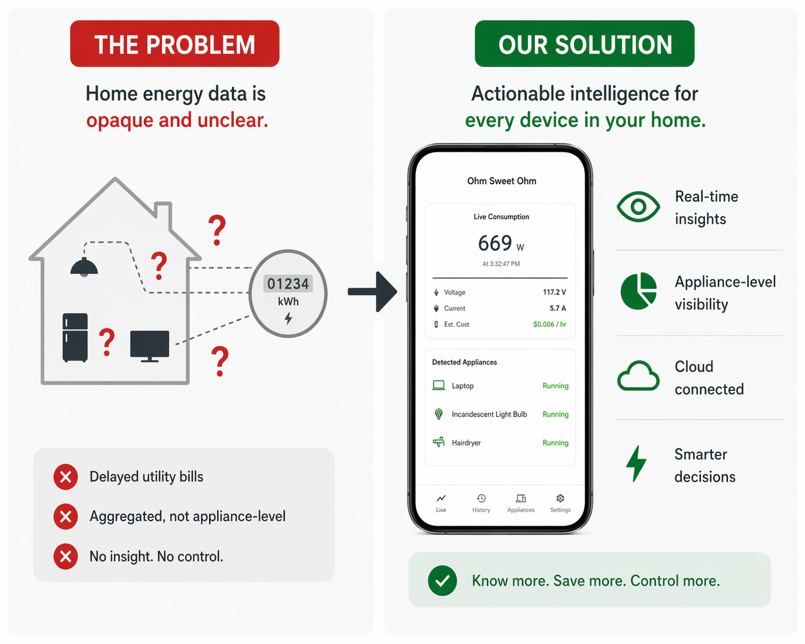
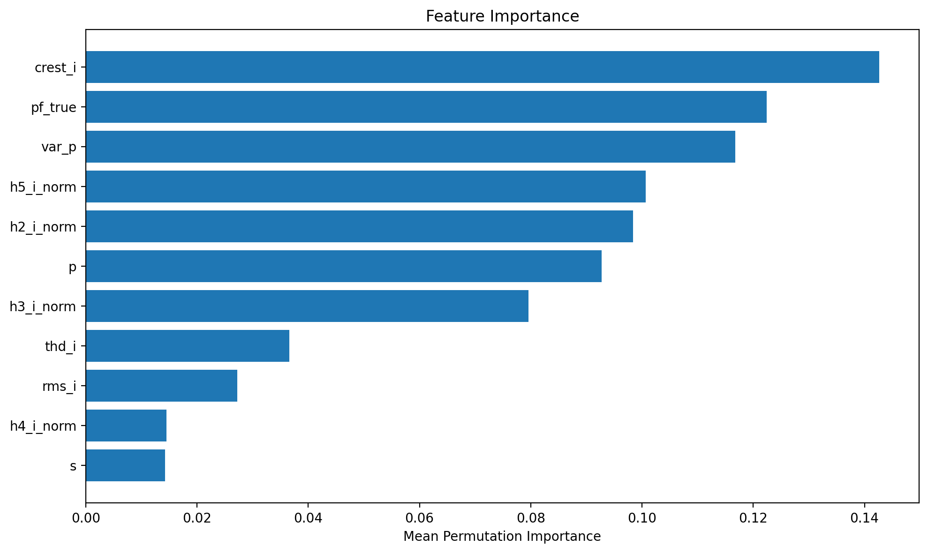
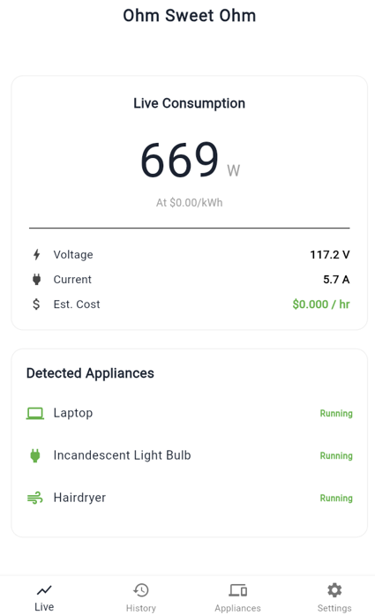
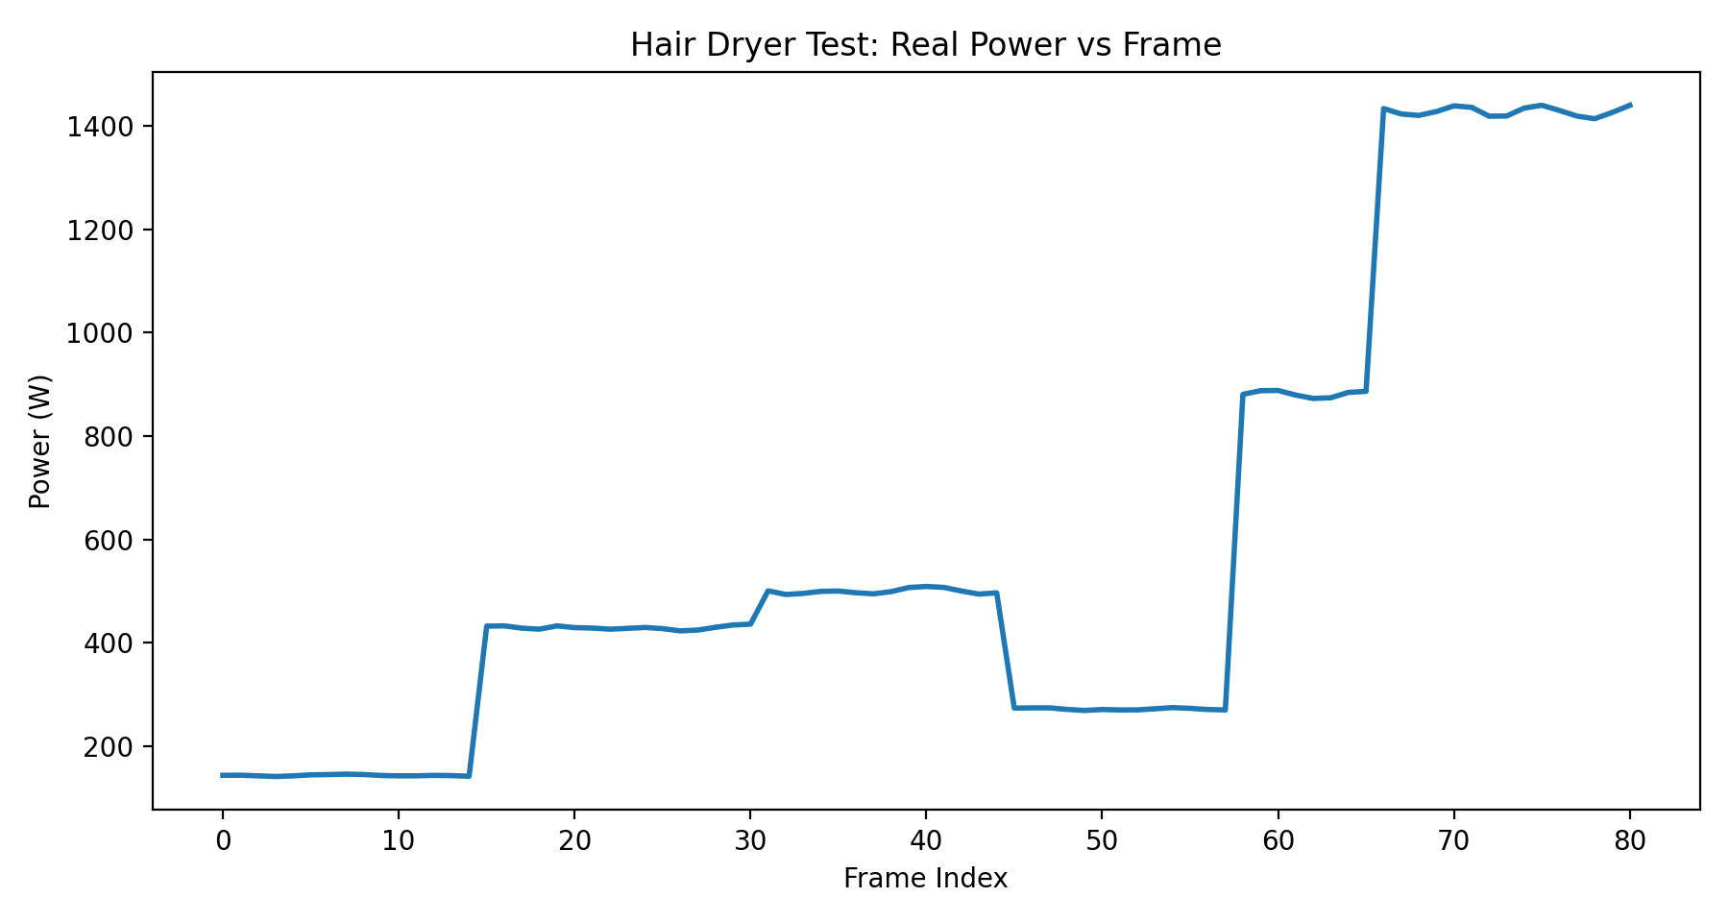
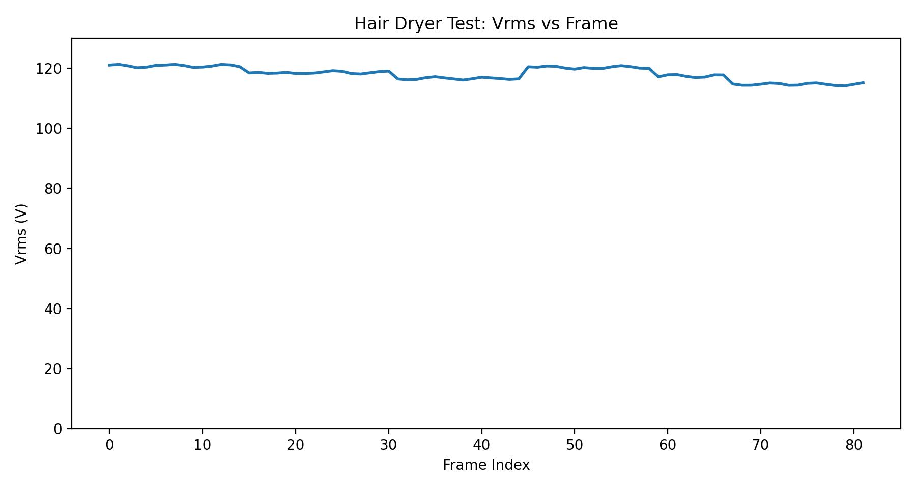
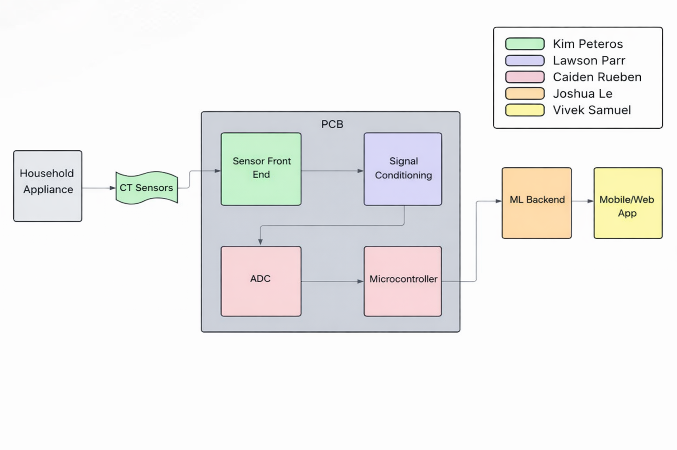
OhmSweetHome
Kim Peteros, Lawson Parr, Caiden Rueben, Joshua Le, Vivek Samuel
Dr. Prasad Enjeti, Dr. John Lusher
Problem Definition
Residential energy use is largely invisible to homeowners. Most people only see total usage on their utility bill, with no real-time or appliance-level insight, making it difficult to understand consumption patterns or identify inefficiencies.
System Design
Sensing: CT clamp and transformer convert current and voltage to measurable signals Conditioning: Filters reduce noise and stabilize signals
Processing: ESP32 samples and computes electrical measurements Integration: Custom PCB combines all components into a compact system
Engineering Analysis
Machine Learning Classification
Trained a multilabel gradient-boosted tree model to detect active appliances from electrical features
Chosen for strong performance on tabular power data and fast cloud inference
Feature importance shows which measurements mattered most to prediction
Electrical Load Characterization
Digital Signal Processing Pipeline
DC bias removal (~1.65V)
Windowed sampling for feature extraction
RMS, power, and power factor calculation
Safe ADC scaling
Outcomes
Our fully integrated system uses custom hardware to capture and filter electrical signals. An embedded microcontroller processes and streams this data to the cloud, where machine learning identifies active appliances for real-time visualization on our mobile app.
Reliable real-time power monitoring with cloud integration
Consistent Vrms (~120V) with dynamic current response
Clear detection of appliance on/off state changes
Machine learning enables appliance-level identification
Impact
Provides homeowners with real-time energy usage insights
Enables identification of inefficient appliances --> cost savings
Scalable for smart home integration and energy monitoring systems
Low-cost alternative to existing commercial solutions
References
“The Sense Home Energy Monitor.” Sense.com, 2018, sense.com/. ‌
“Danfoss – Engineering Tomorrow.” Www.danfoss.com, www.danfoss.com/en/. ‌
Acknowledgments
We would like to express our sincere gratitude to Dr. John Lusher, Dr. Prasad Enjeti, and Roman Venegas for their invaluable guidance and support throughout this project. Their expertise and feedback played a key role in shaping our design and overcoming technical challenges.
Device/Scenario | Current (A) | Power (W) | Behavior
Hair Dryer | ~0-12.8 | ~0-1536 | Step increase with fan/heat settings
Toaster | ~0-6 | ~0-720 | Binary ON/OFF resistive load
Lamp (Touch LED) | ~0.06 | ~7 | Stable low-power lighting load
Laptop Charger | ~0.7-1.0 | ~84-120 | Consistent low–mid power draw
Combined Load | ~5.\8-6.1 | ~696-7 | Stable aggregate multi-device response

